Slide 1
GRANITE SHOP MANAGEMENT SYSTEM

Slide 2
ABSTRACT
A granite shop management system is a help of managing the shop, we no need to managing the shop manually, this system will take care for the all the process of the application from top to end. Hope it’s really helpful for the satisfying customer and company relationship. This system is actually act as an admin is a shop employees or owners they have enter into the login and using the features which explained below. When customer has purchase which system collect the all the information from the customer and add into the database, purchase module will handle the purchasing, sales module will handle the sales entries and billing module will be handle billing details of the shop.
The main goal of this project is that reducing the man power and giving an accurate information to the customer, and managing the stock and billing details of the store. The project is aimed to develop by JAVA as Front end and SQL as Back end.

Slide 3
HARDWARE SPECFICATION
Processor : P 4 700 GHz.
RAM : 4 GB RAM
Hard Disk Drive : 180 GB

Slide 4
SOFTWARE SPECIFICATION
Operating System : Windows 7/8/10
Front End : JAVA
Back End : SQL

Slide 5
EXISTING SYSTEM
An existing system of granite management system is a manually we can check the quantity of material count. It takes a too man power works to complete the task. We just count the stock report as a manually and which does not give an accurate result, it’s just getting irritation to the people who are doing this task. A material purchase and sales details can’t handle this system, but in this system.
Disadvantages
It’s very risky to manage granite system
Man power work impossible.
Used only in low level business

Slide 6
PROPOSED SYSTEM
A proposed system of granite management system is that for we can takes a purchase, sales, stock and billing module have to be covered. So, we no need to bother about the product. In this system we can build it too anywhere. This system has to be working fully automatically.
Advantages
Showing a billing report
very easy to find the stock details
contact with customers

Slide 7
Modules
Admin Login
Admin is an only having an access to login, admin having access to use these below modules. admin using username and password to do login, if it’s an incorrect we won’t allow into the application
Customer Registration
A customer registration module is used collect the information details. Which is used to when the granite shop owner contacts the customer this will help to give the contact details about the customer.
Product Registration
A product module is collect all the information about the product , before purchasing the user should enter the product details and then the product details will be stored in the product table

Slide 8
Purchase Module
when the manager purchasing the products or material, they should register this purchase module. It’s managed by shop owner then collect the information about the product details and price etc… After the purchasing only should sales the product.
Sales Module
This module calling when the customer has to be purchased and before billing. It will show the all the details about the product. Which is basically used to find the stock entry details. A sales module collects the customer information so we can contact the customer easily.

Slide 9
Stock module
This Stock module will be helps to find the what are all the products are available in shop and how many products are in stock also we can check. No need to manually count a check and verify the product. Systematically it will calculate and give a report.
5. Billing Module
This module shows a billing detail, what are the items are sales in date wise and how much are they gain. Total entire application will be showing in this module.

Slide 10

Data Flow Diagram
Level 0:

Slide 11
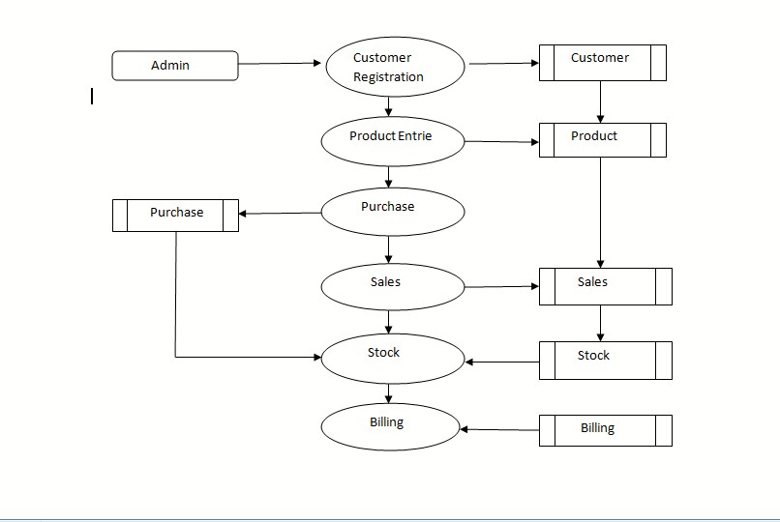
Level 1:

Slide 12
TABLE DESIGN
TABLE NAME: ADMIN
FIELD | DATA TYPE | SIZE | CONSTRAINT
Admin id | Int | 10 | Primary key
Username | Varchar | 30 | Not null
password | Varchar | 30 | Not null

Slide 13
TABLE NAME: CUSTOMER
FIELD | DATA TYPE | SIZE | CONSTRAINT
Id | Int | 10 | Primary key
Name | Varchar | 30 | Not null
Mobile | Int | 10 | Not null
Email | varchar | 10 | Not null
Address | Varchar | 50 | Not null
Gender | Varchar | 10 | Not null

Slide 14
TABLE NAME:PRODUCT
FIELD | DATATYPE | SIZE | CONSTRAINT
Product id | Int | 10 | Product id
Company name | varchar | 10 | Not null
Product Name | Varchar | 30 | Not null
Weight | Int | 10 | Not null
Price | int | 10 | Not null

Slide 15
TABLE NAME: PURCHASE
FIELD | DATA TYPE | SIZE | CONSTRAINT
Purchas id | Int | 10 | Primary key
Product Name | Varchar | 10 | Foreign key
Quantity | Int | 5 | Not null
Price | Int | 10 | Not null

Slide 16
TABLE NAME: SALES
FILED | DATA TYPE | SIZE | CONSTRAINT
Salesid | int | 10 | Primary key
Mobile No | int | 10 | Foreign key
Customer Name | varchar | 10 | Foreign key
Product Name | varchar | 10 | Foreign key
Quantity | int | 5 | Not null
Price | int | 10 | Not null

Slide 17
TABLE NAME: STOCK
FIELD | DATA TYPE | SIZE | CONSTRAINT
Stockid | int | 10 | Primary key
Company Name | Varchar | 10 | Foreign key
Product Name | Varchar | 10 | Foreign key
Quantity | Int | 5 | Not null
Price | int | 10 | Not null

Slide 18
TABLE NAME: BILLING
FIIELD | DATA TYPE | SIZE | CONSTRAINT
Billingid | int | 10 | Primary key
Date | date | 10 | Not null
Customer Name | Varchar | 10 | Foreign key
Company Name | varchar | 10 | Foreign key
Product Name | varchar | 10 | Foreign key
Quantity | int | 5 | Not null
price | int | 10 | Not null

Slide 19
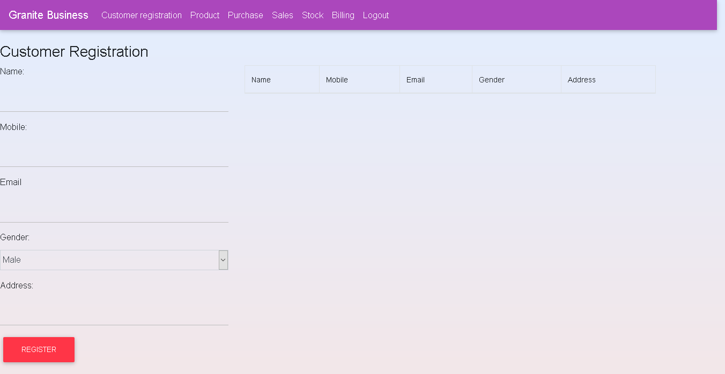
FORM DESIGN

Slide 20
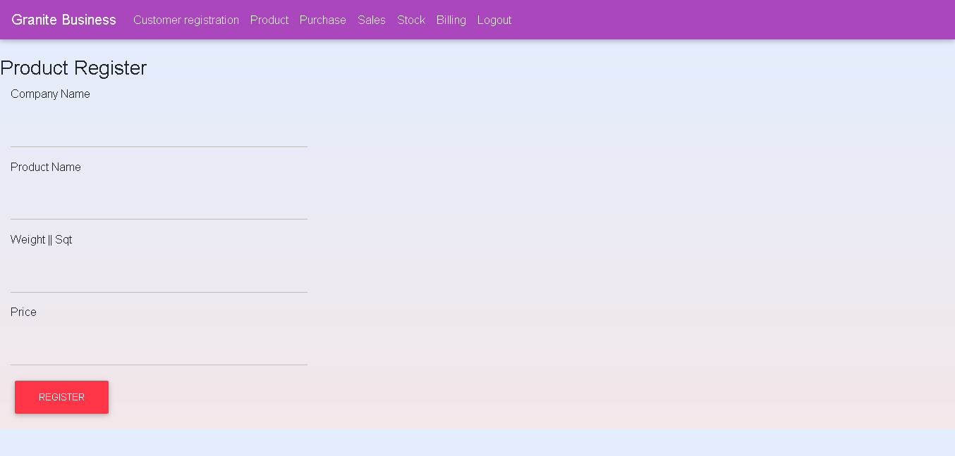

Slide 21
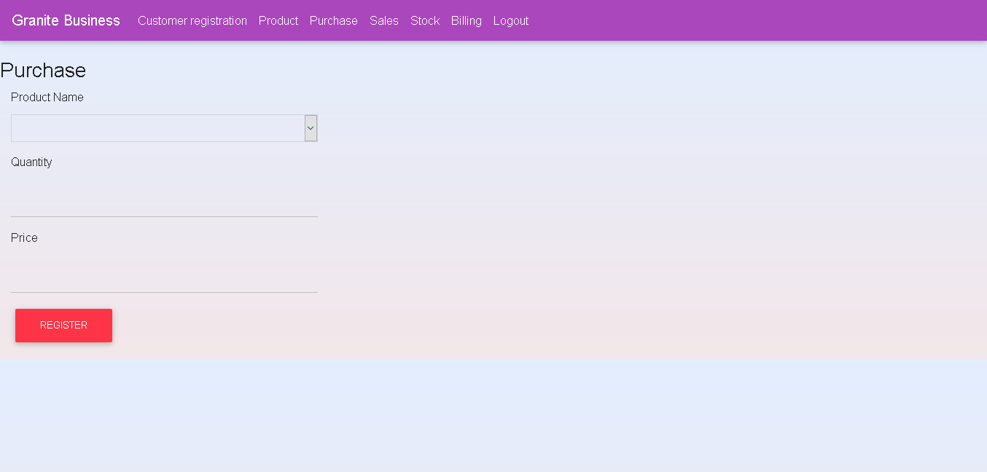

Slide 22
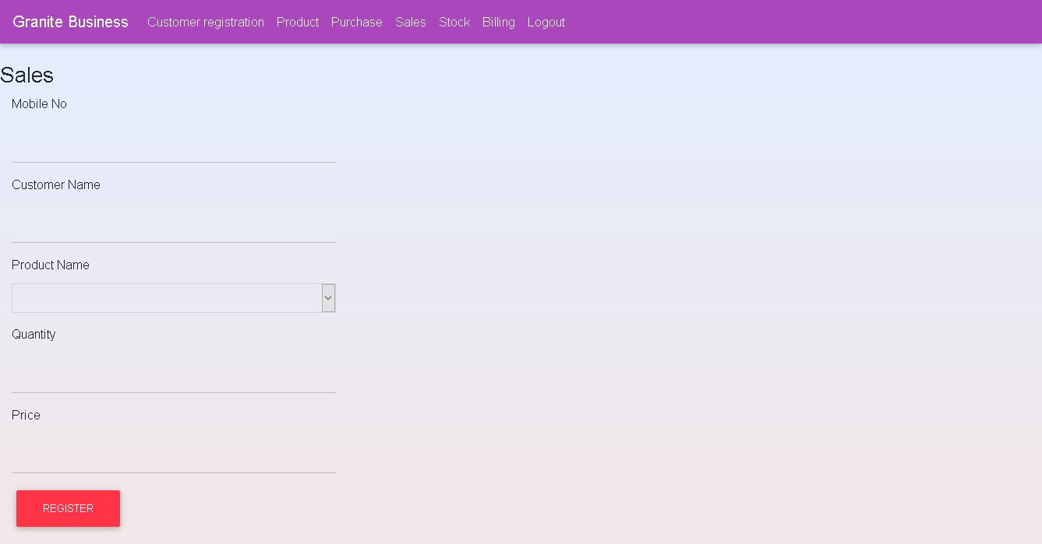

Slide 23
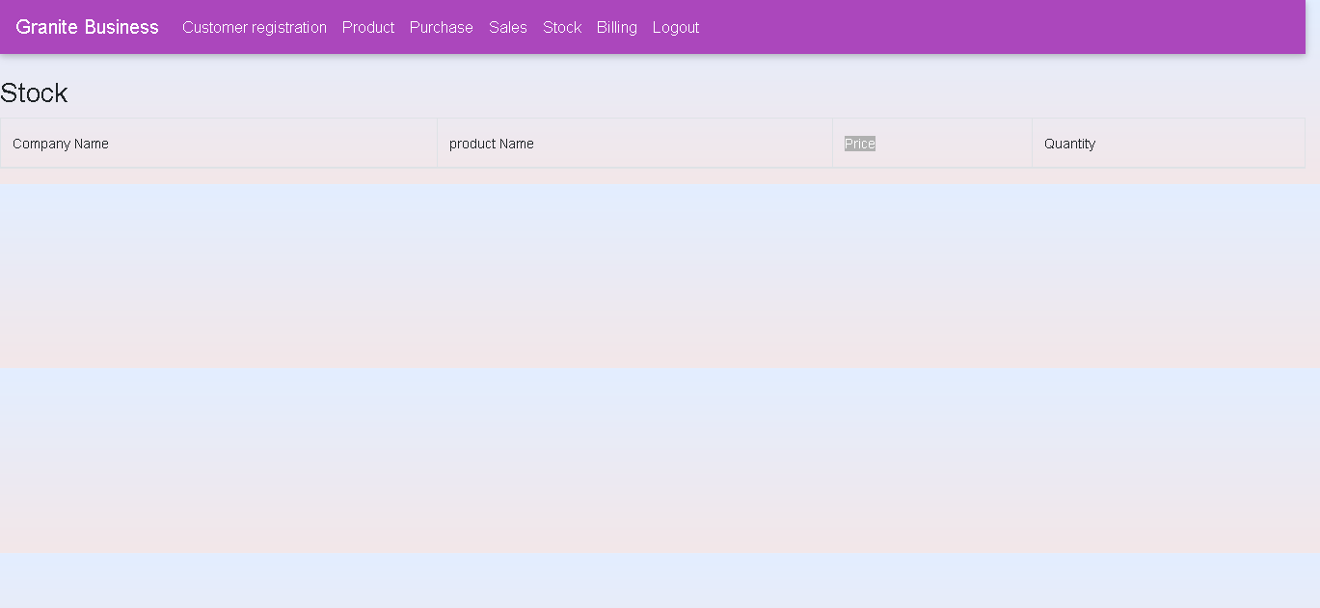

Slide 24
